Slide 1
ME457 Final Presentation
Team Oiler
Benjamin Aziel, Sohaib Bhatti, Kyle Deolall, Ariel Tamayev

Slide 2
This Week’s Plan
Implement graphs and data collection
Trim Control and Autopilot (Ch. 5, 6)
Kalman Filter Implementation (Ch. 7, 8) (if we have time)
INDI Controller Analysis (if we have time)

Slide 3
Chapters 5-6
Compute Models (Derivatives)
Trim file (Minimize J Function)
Autopilot Tecs

Slide 4
Chapters 7-8
Add sensors to simulation
Implement Kalman filter for state estimations
Have autopilot use estimated states instead of true states

Slide 5
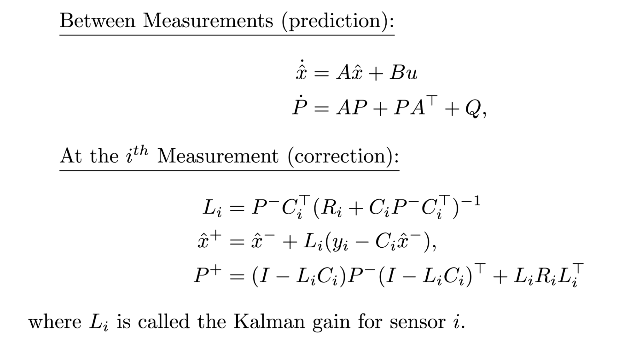
Kalman Filter

Slide 6
Nonlinear Dynamic Inversion (NDI)
Aerodynamics isn’t a very linear field, so let’s use a nonlinear controller
Control a nonlinear system in a form similar to as if it was linear- this is called NDI

Slide 7

Methodology
Let’s start with a SISO model
$\dot{x}=f\left(x\right)+g\left(x\right) u$
$f(x)$ isn’t necessarily linear
Rewrite $\dot{x}=f\left(x\right)+g\left(x\right) u$ in a form such that all the nonlinear terms only affect one entry in the state vector (a companion form, perhaps?)

Slide 8
METHODOLOGY
Once the model Is rewritten in a linear state-space-esque form, we can apply linear control methods by defining a virtual control input

Slide 9
Issues
NDI is pretty great for aerodynamic/fluid models, but:
Overreliance on models and measurements causing possible instability

Slide 10
INDI
A variation on NDI that reduces the controller’s reliance on the model by sampling data from the CL system
Has only been implemented in actual flight 2 times (as of 2019)
Crazyflie implemented an INDI controller!

Slide 11
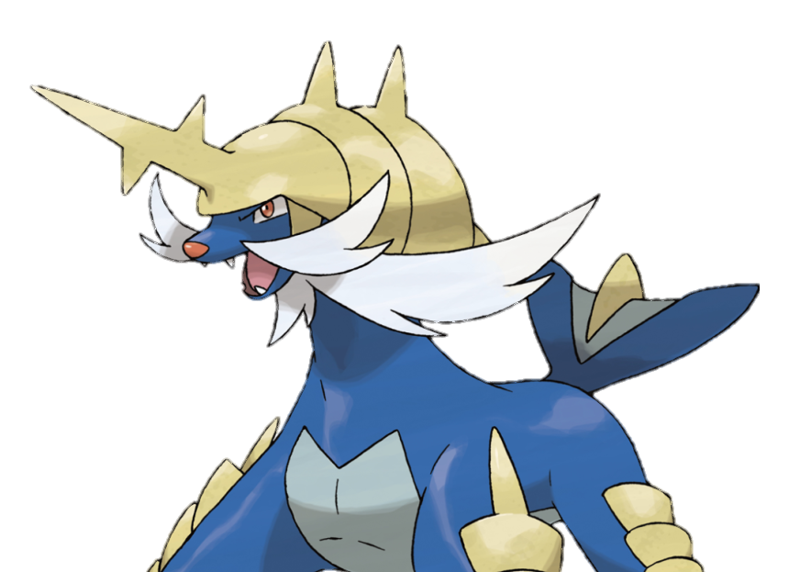
CODE:
https://github.com/destrospooder/me457_dronecontrol
- If we could iterate on the code later, I’d use a numerical calculations library that allowed for stacking of different shaped arrays OR use MATLAB.

